Slide 1
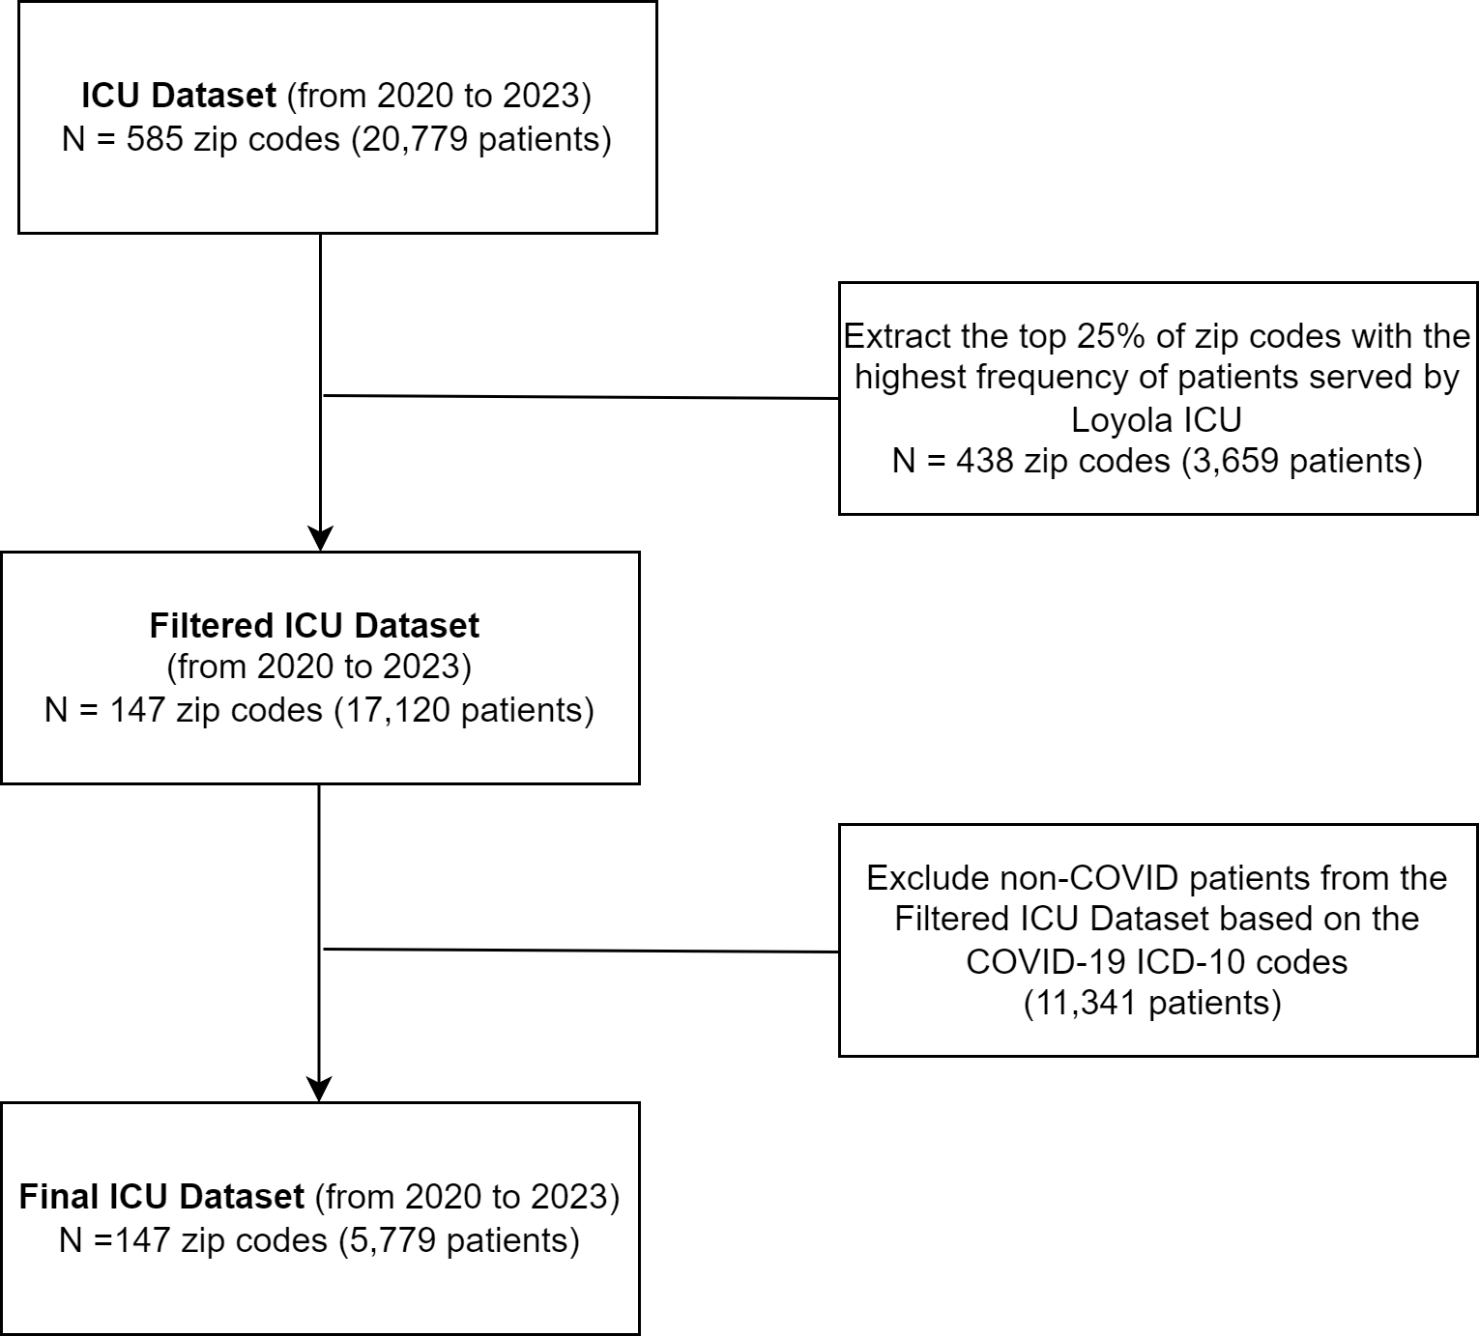
The Role of SHIELD Test Centers in Reducing COVID-19 ICU Admissions in Disadvantaged Communities
Alireza Kasaie, Ph.D., William F. Parker, M.D., Ph.D., Milda Saunders M.D., M.P.H, Sina Ansari, Ph.D., Mohammad Samie Tootooni, Ph.D.
Loyola University Chicago, Department of Health Informatics and Data Science
Introduction
Results
An increase of one effective SHIELD test center in highly disadvantaged zip codes is estimated to reduce ICU admissions by approximately 51,774, lowering the average ICU admission rate from 0.063 to 0.057
During the Delta wave, increasing the effective number of SHIELD test centers by one unit is estimated to reduce ICU admissions by approximately 61,903, lowering the average ICU admission rate from 0.045 to 0.043
During the Omicron wave, increasing the effective number of SHIELD test centers by one unit in highly disadvantaged zip codes is estimated to reduce ICU admissions by approximately 89,002, lowering the average ICU admission rate from 0.063 to 0.056
Covid-19 impact
Over 7 million global death; 1-2% mortality rate; high admission rates¹⁻³
Disproportionate Effect
Disadvantaged communities (measured by ADI) face higher COVID-19 cases, deaths, and ICU admissions⁴⁻⁵
Testing as a Critical Tool
Early detection through testing, especially in vulnerable communities, is key to managing the pandemic⁶
SHIELD Illinois
Saliva-based COVID-19 testing program widely implemented in Illinois, with a focus on schools and underserved communities
Gap in Research
Limited studies on the impact of SHIELD testing on ICU admissions, particularly in socioeconomically disadvantaged areas
Objectives
Conclusion
Assess the relationship between the effective number of SHIELD test centers and COVID-19 admission rates in disadvantaged communities
Figure 2: Trends of SHIELD test centers and effective number of SHIELD centers over time for all zip codes
During the Alpha and Delta waves, the effective number of SHIELD test centers did not significantly lower ICU admission rates.
In Omicron wave, a higher proportion of effective SHIELD centers led to a statistically significant reduction in COVID-19 ICU admission rates, particularly in disadvantaged areas.
Lag analysis demonstrated that increasing the effective number of SHIELD centers resulted in sustained reductions in ICU admissions over time, especially in socioeconomically disadvantaged areas.
The success of testing programs like SHIELD hinges on not just the number of centers, but their strategic placement in areas most in need, and their operational efficiency to maximize impact.
Relying solely on the total number of SHIELD centers could be misleading, as it does not account for whether these centers were actively utilized or accessible to the community
The root mean square error (RMSE) between the average number of SHIELD test centers and the average effective number across all zip codes over time is 0.94
Methods
Figure 1: Data Filtration Diagram
Alpha Wave
Delta Wave
Omicron Wave
References
[1] Worldometer, “COVID-19 Stats,” https://www.worldometers.info/coronavirus/
[2] Centers for Disease Control and Prevention, “CDC Museum COVID-19 Timeline,” https://www.cdc.gov/museum/timeline/covid19.html
[3] D. Cucinotta and M. Vanelli, “WHO declares COVID-19 a pandemic,” Acta bio medica: Atenei parmensis, vol. 91, no. 1, p. 157, 2020
[4] O. Abdulfattah, A. Kohli, P. White, C. Michael, and Z. Alnafoosi, “Impact of the COVID-19 Pandemic on Hospital Admission Rate, Length of Stay, and Mortality Rate for Patients with Chronic Obstructive Pulmonary Disease Exacerbation: A Retrospective Study.,” J Community Hosp Intern Med Perspect, vol. 14, no. 2, p. 1, 2024
[5] G. Grasselli et al., “Baseline characteristics and outcomes of 1591 patients infected with SARS-CoV-2 admitted to ICUs of the Lombardy Region, Italy,” JAMA, vol. 323, no. 16, pp. 1574–1581, 2020
[6] National Institute of Health (NIH), “Why COVID-19 testing is the key to getting back to normal,” https://www.nia.nih.gov/news/why-covid-19-testing-key-getting-back-normal
Linear Mixed-Effect Regression Model (LMM)
Fixed Effects: Effective number of SHIELD centers per zip code per month; state ADI; Interaction term
Random Effects: Zip code-level random intercept for clustering of monthly COVID-19 ICU admission rate
Robustness Checks
Lag analysis with two-month lags to examine the timing of testing and its effect on subsequent COVID-19 admissions
Figure 3: Trends in COVID-19 ICU admission rates and effective number of SHIELD test centers across zip codes over time
High Disadvantaged areas experienced a greater burden of severe COVID-19 cases, despite increased testing center availability

